Slide 1














CREDIT CARD WEEKLY CREDIT REPORT
Presented by BHAVYA SHARMA

Slide 2

TABLE OF CONTENT
Project Objective
Data from SQL
Data Processing & DAX
Dashboard & Insights

Slide 3
PROJECT OBJECTIVE
Create a weekly credit card dashboard to deliver real-time insights into performance metrics and trends. This will allow stakeholders to efficiently monitor and analyze operations, enhancing decision-making and operational effectiveness in credit card services, while adapting swiftly to market and customer dynamics.

Slide 4


Import Data to SQL Database
Prepare csv file
Create tables in SQL
Import csv file into SQL

Slide 5
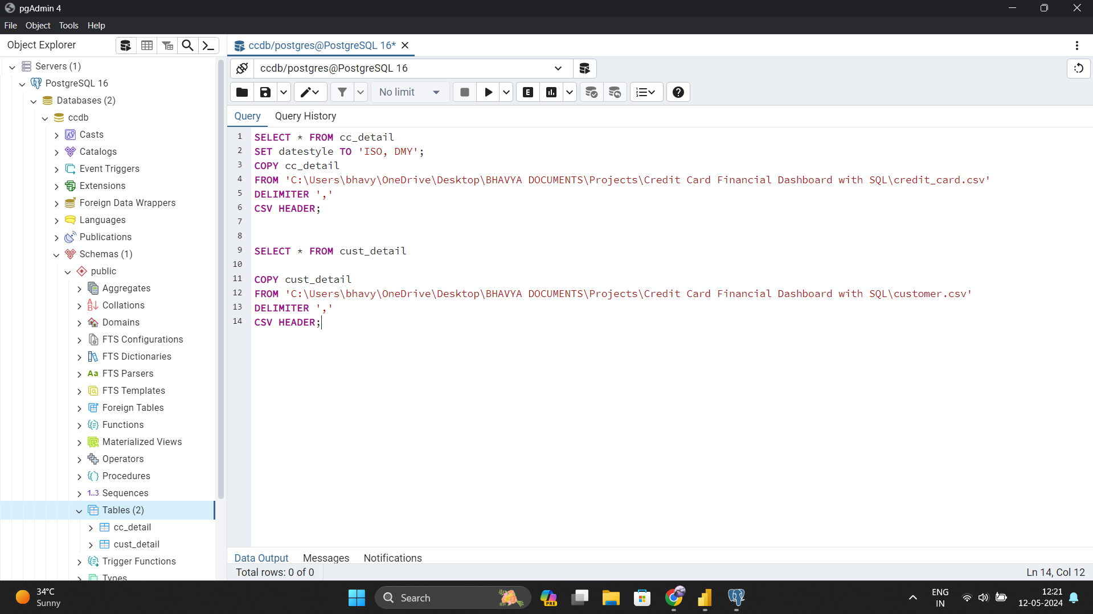
POSTGREE SQL

Slide 6


DAX Queries
AgeGroup = SWITCH(
TRUE(),
'public cust_detail'[customer_age] < 30, "20-30",
'public cust_detail'[customer_age] >= 30 && 'public cust_detail'[customer_age] < 40, "30-40",
'public cust_detail'[customer_age] >= 40 && 'public cust_detail'[customer_age] < 50, "40-50",
'public cust_detail'[customer_age] >= 50 && 'public cust_detail'[customer_age] < 60, "50-60",
'public cust_detail'[customer_age] >= 60, "60+",
"unknown"
)
IncomeGroup = SWITCH(
TRUE(),
'public cust_detail'[income] < 35000, "Low",
'public cust_detail'[income] >= 35000 && 'public cust_detail'[income] <70000, "Med",
'public cust_detail'[income] >= 70000, "High",
"unknown"
)

Slide 7
DAX Queries
week_num2 = WEEKNUM('public cc_detail'[week_start_date])
Revenue = 'public cc_detail'[annual_fees] + 'public cc_detail'[total_trans_amt] + 'public cc_detail'[interest_earned]
Current_week_Reveneue = CALCULATE(
SUM('public cc_detail'[Revenue]),
FILTER(
ALL('public cc_detail'),
'public cc_detail'[week_num2] = MAX('public cc_detail'[week_num2])))
Previous_week_Reveneue = CALCULATE(
SUM('public cc_detail'[Revenue]),
FILTER(
ALL('public cc_detail'),
'public cc_detail'[week_num2] = MAX('public cc_detail'[week_num2])-1))

Slide 8
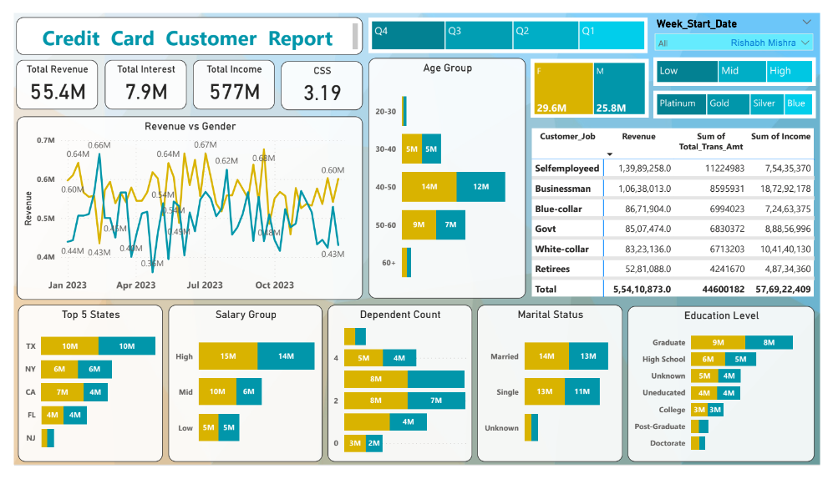
POWER BI DASHBOARD

Slide 9
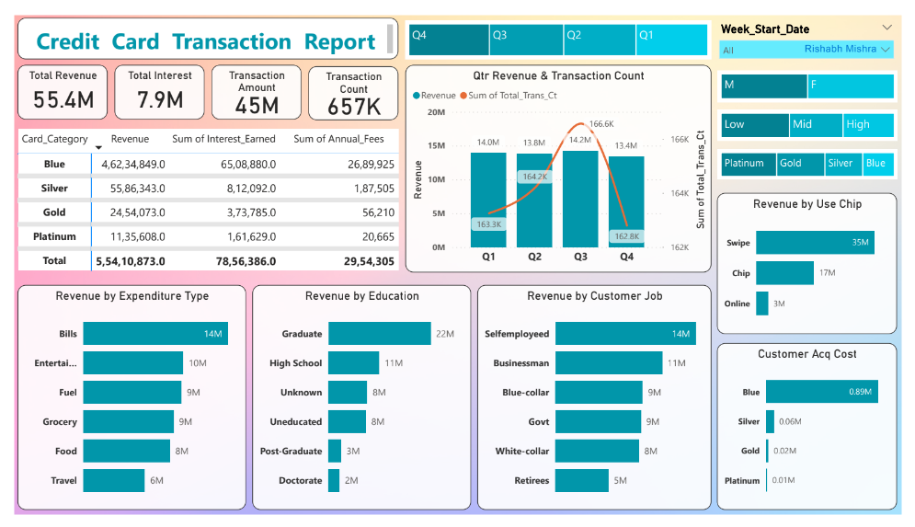
POWER BI DASHBOARD

Slide 10
FINDINGS & INSIGHTS
• Revenue increased by 28.8%,
• Total Transaction Amt & Count increased by xx% & xx%
• Customer count increased by xx%
• Overall revenue is 57M
• Total interest is 8M
• Total transaction amount is 46M
• Male customers are contributing more in revenue 31M, female 26M
• Blue & Silver credit card are contributing to 93% of overall transactions
• TX, NY & CA is contributing to 68%
• Overall Activation rate is 57.5%
• Overall Delinquent rate is 6.06%

Slide 11
Thank you very much!

